Slide 1
Core Discussion Networks

Slide 2
Core discussion networks: What are they?
A great deal of what we know about ego-networks at the population level comes from core discussion networks
These are ego-networks elicited by a particular name generator:
  “Named all persons with whom you have discussed matters important to you”
First implemented in General Social Survey 1985 as first probability sample of ego-networks
  Replicated by McPherson and Smith-Lovin in GSS 2004

Slide 3

Core discussion networks: What are they?
The larger the ego network:
  The more diverse, less homophilous, more open
Smaller ego networks:
  Tend to be more clustered , less diverse
The more diversity
  Less homophily
The higher average tie strength
  The more clustering, less diversity
The more proportion kin
  The more homophily, less diversity, more clustering

Slide 4
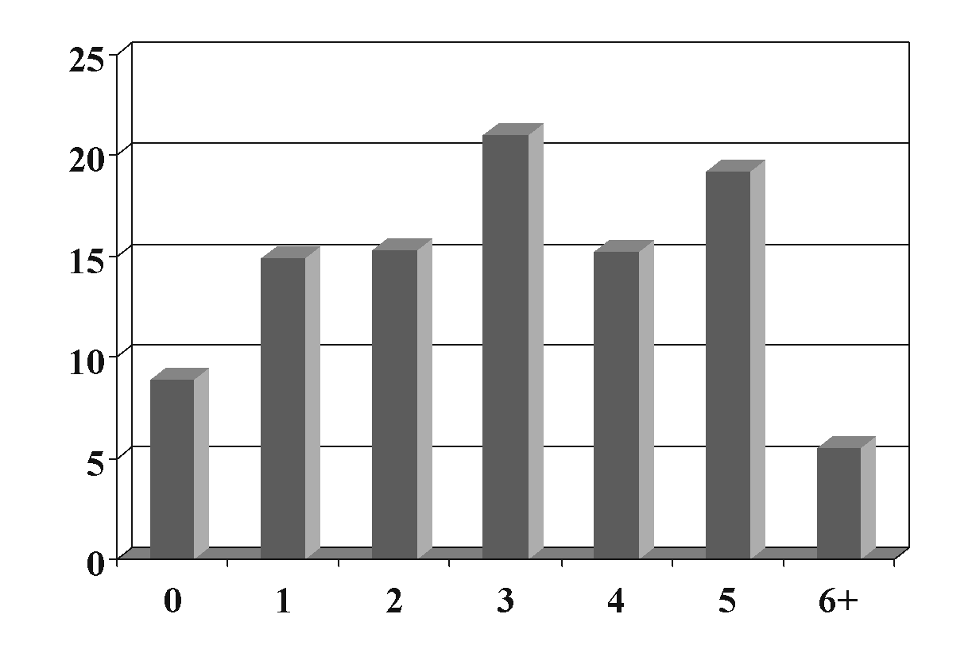
Core discussion networks: What are they?
Core discussion networks:
  Tend to have wide variation in size
    Some people have lots of contacts
    Some are “isolated”
  Size:
    Increases with education
    Declines with age
    Blacks report smaller networks
    No gender differences
Distribution of total network size
GSS 1985

Slide 5
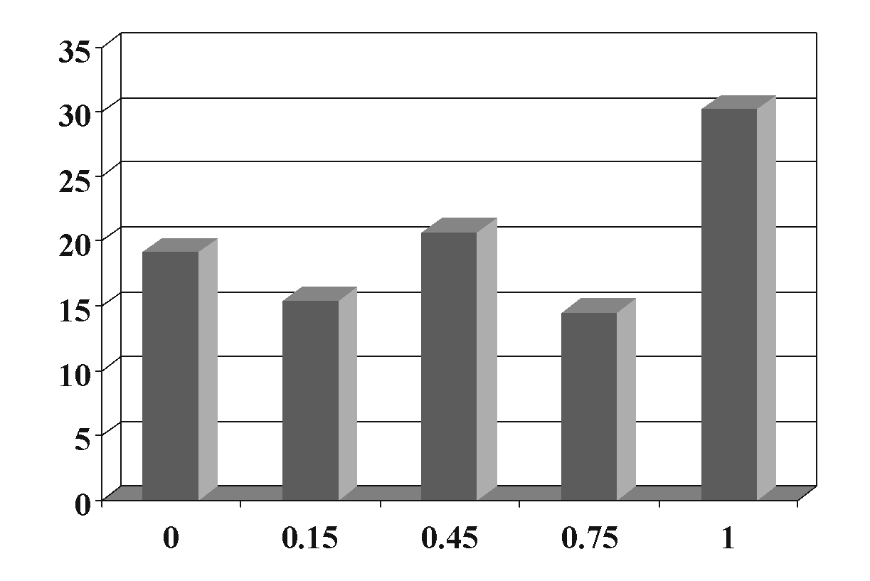
Core discussion networks: What are they?
Core discussion networks:
  Tend to be dominated by kin
  Proportion kin:
    Declines with education
    Women report more kin
    Blacks report fewer kin
    Larger for the really young and the really old
Proportion Kin, GSS 1985

Slide 6
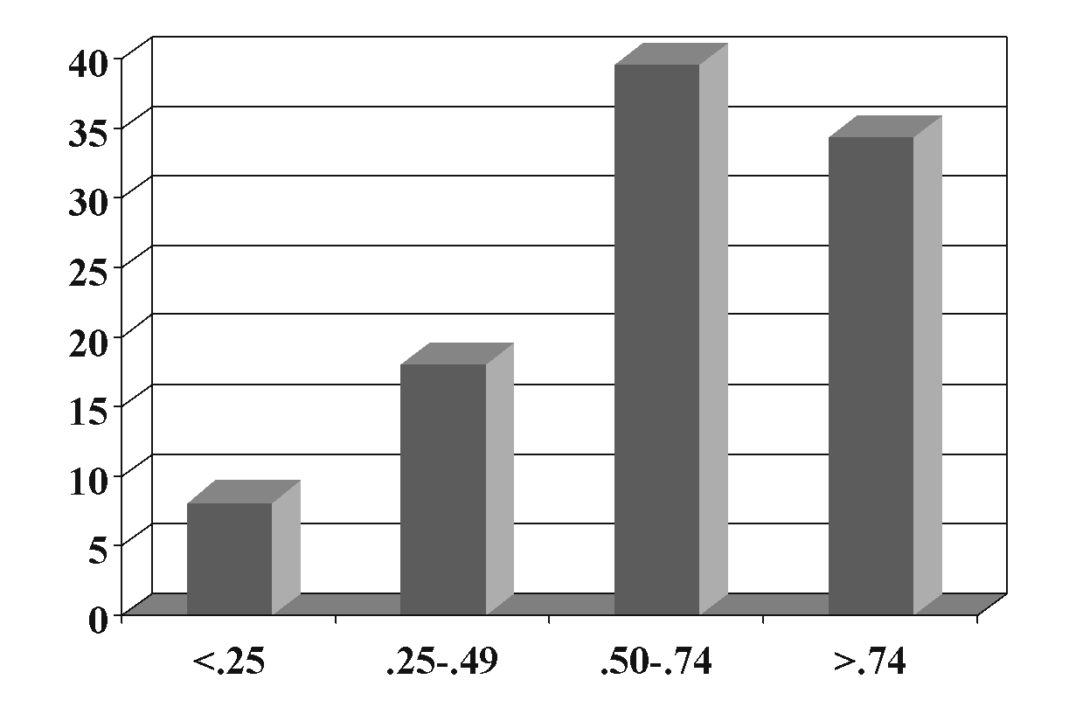
Core discussion networks: What are they?
Core discussion networks:
  Tend to be relatively clustered
  Clustering:
    Increases as we age
    Declines with education
    Declines with population size of place
Core discussion network clustering GSS 1985

Slide 7
Core discussion networks: What are they?
Core discussion networks:
  Tend to be relatively homogeneous with respect to important social attributes (Homophily)
    Age, race, gender, education
  Homogeneity:
    Increases with age
    Declines with education
    Non-whites have less
      Blau’s size paradox
    Declines with size of place
    Interacts with kin status in complex ways
Core discussion network clustering GSS 1985

Slide 8
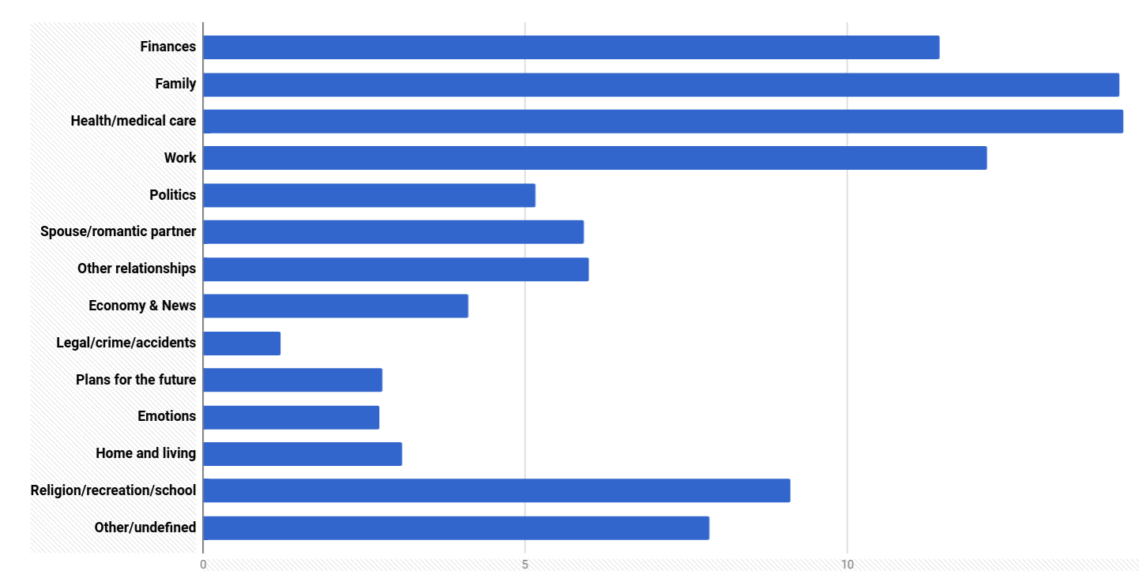
What are important matters? (Brashears 2016)

Slide 9
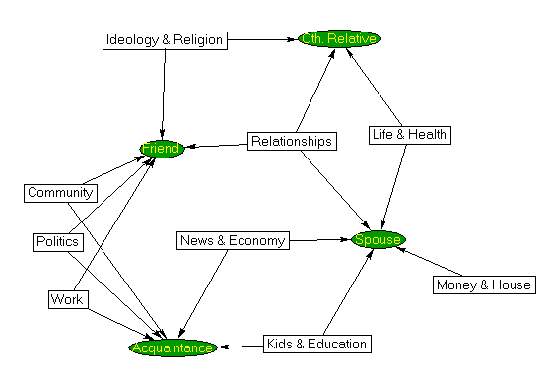
What are important matters?
Are important matters important?
  “Big Four” (Brashears 2014):
    Finances, Family, Health and Medical Care, and Work
  People mainly rely on friends and non-spousal kin followed by spouses
  People tend to link topics to role types
    Small gender differences
  People get important forms of support from confidants (Brashears 2014):
    Confirms the use of this name generator as exchange/resource
Bearman and Parigi (2004)

